Slide 1
How Does a Bike-Share Navigate Speedy Success
Nick Ferguson

Slide 2
Introduction
Cyclistic is a fictional bike-share company in Chicago
Director of Marketing believes that Cyclistic’s future depends on annual memberships, and wants to convert casual riders into annual members.
Data will be explored to find the differences, if any, between casual users and annual members, something many companies are looking for in the current market space.

Slide 3
Business Task
Investigate why casual riders would buy annual membership by using data to determine the differences between casual riders and annual members and why might casual riders buy an annual membership. Provide recommendations to the marketing team on how to influence casual riders into buying annual memberships using digital media.

Slide 4
Data used in analysis
The data used in analysis is the data from https://divvy-tripdata.s3.amazonaws.com/index.html
The actual data is the data from March 2021 to March 2022 for 12 months of bike-share data.
Data was validated with no errors and no duplicate observations. Data was cleaned to remove any negative trip lengths, or when bikes were taken out of docks to be checekd by Divvy.
New variables were created for ride length, month, day and year.

Slide 5
Descriptive Statistics of All Trips for March 2021 to March 2022
Average Ride Length = 21.75 minutes
Median Ride Length = 11.87 minutes
Max Ride Length = 55,944.15 minutes or roughly 39 days
Min Ride Length = 0 minutes
Saturday has the most rides with 991,956 rides

Slide 6
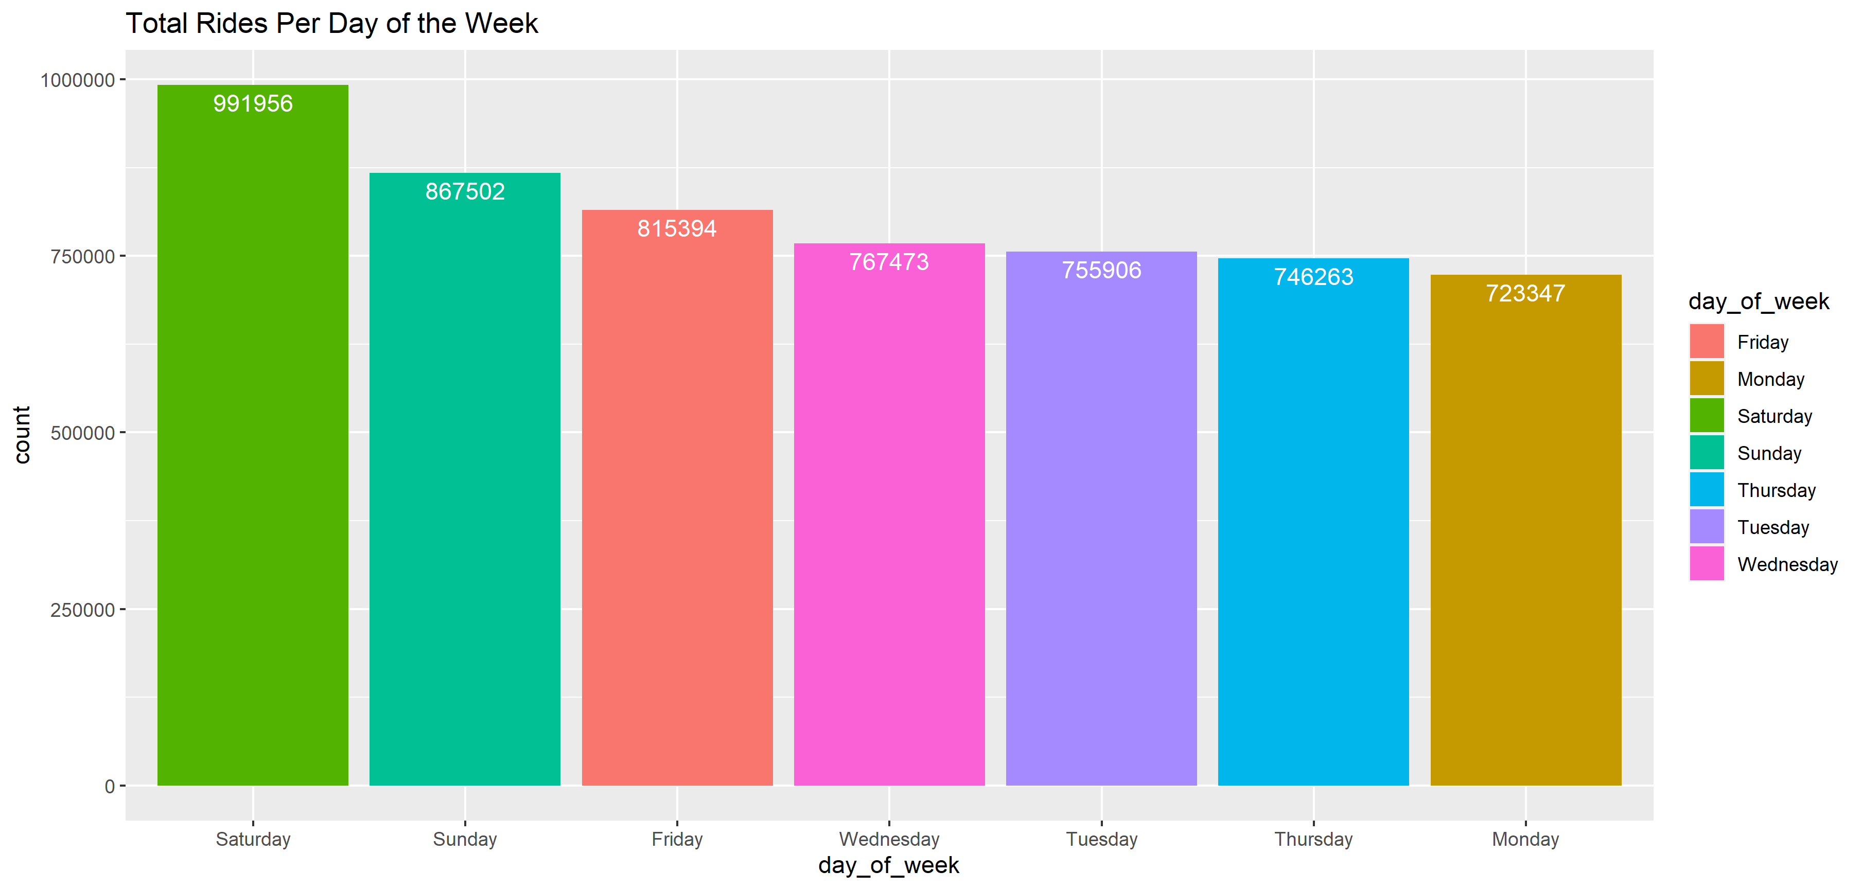

Slide 7
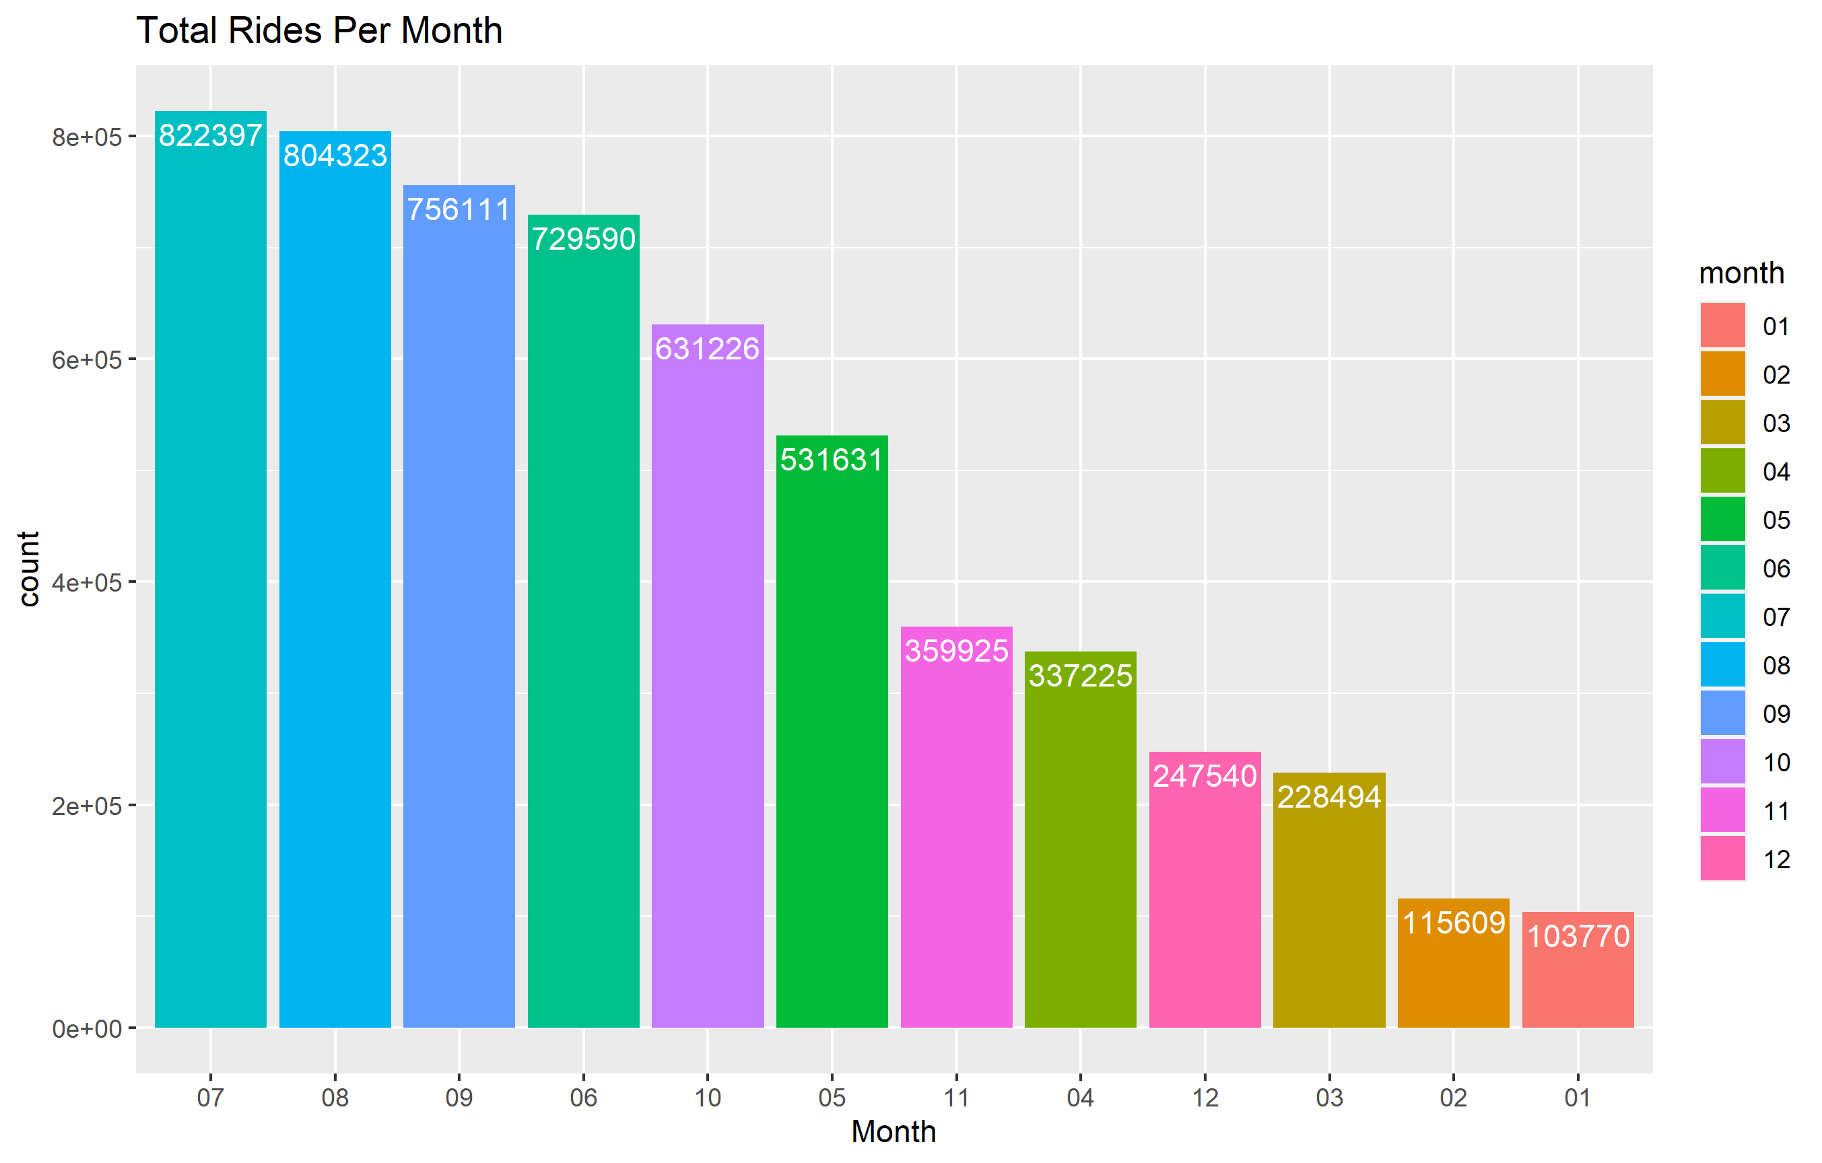

Slide 8
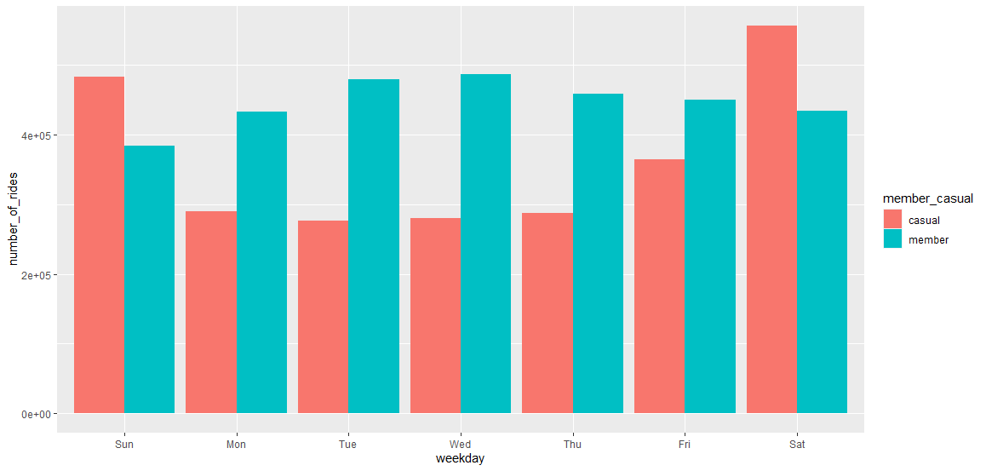
Total number of rides by day of the week
This graph splits the total number of rides by casual rider and annual member.
The only days of the week where annual members do not surpass casual riders is the weekend (Saturday and Sunday).

Slide 9
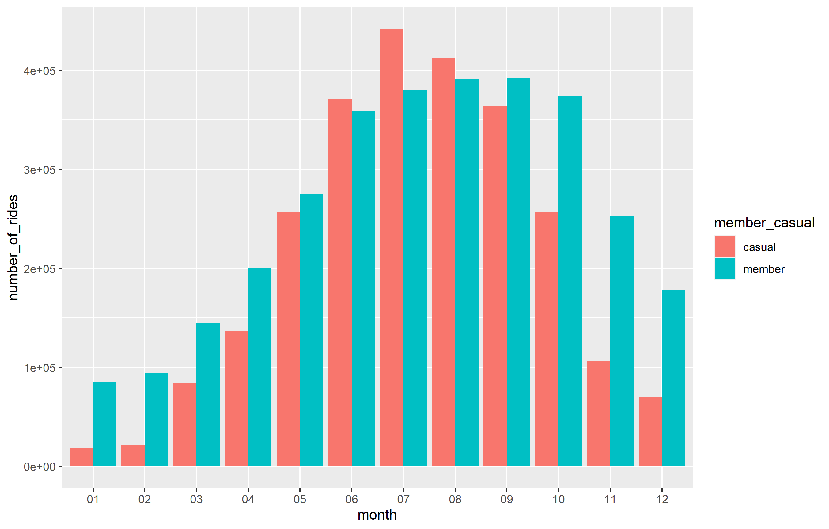
Total number of rides by month
This graph splits the total number of rides by casual rider and annual member.
The only months where casual riders out number annual members are June through August, the warmer months in Chicago.

Slide 10
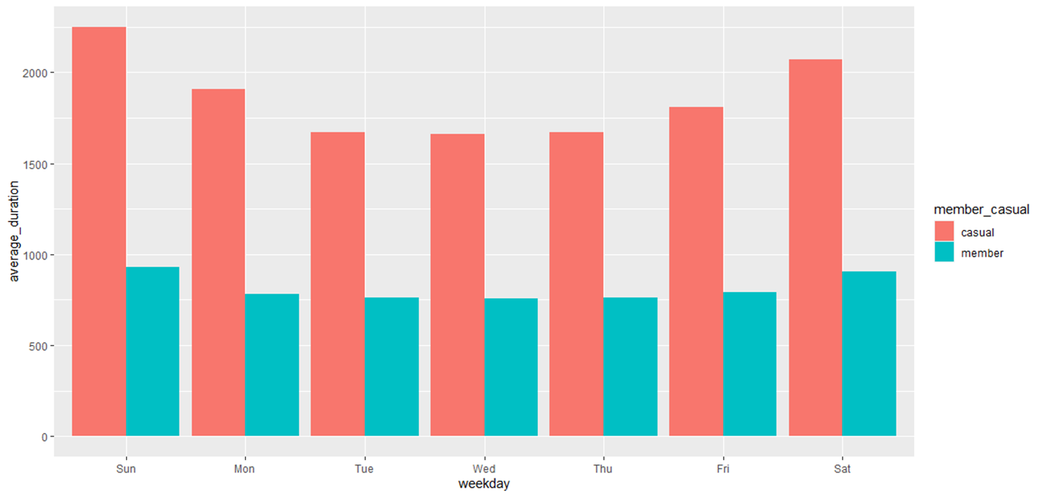
Average Ride Length
This graph splits the total number of rides by casual rider and annual member.
Every single day, the average ride length is higher for casual riders than for annual members.

Slide 11
Recommendations
Increase social media targeting to casual riders on the weekends, as casual riders are more likely to use the bikes on the weekend.
Casual riders ride for a longer amount of time than annual members. Perhaps change the pay structure for casual members to get a discount on their ride if they sign up as annual members.
Increase social media targeting to casual riders during the summer months, as casual riders use bike sharing more in the summer.

